Slide 1

Artificial Intelligence
Introduction
Modified slides of CS-188 Berkeley University

Slide 2
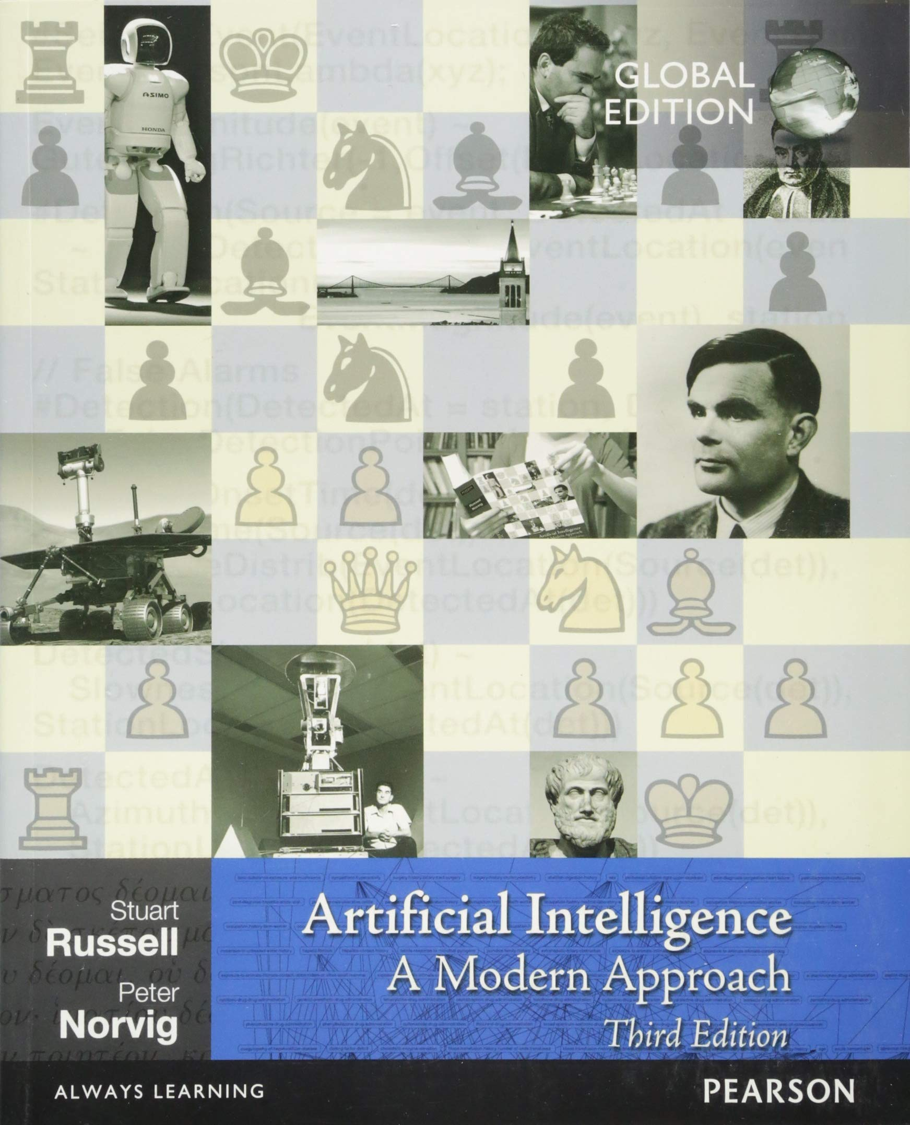

Recommended Books
Artificial Intelligence: A Modern Approach,
Russell & Norvig.
“Artificial Intelligence Illuminated”
Ben Coppin,
(http://futuresoft.yolasite.com/resources/Artificial%20Intelligence%20Illuminated.pdf)

Slide 3
Recommended Books
“Artificial Intelligence – Structures and Strategies for Complex problem solving”, George F. Luger, Pearson International Edition, Sixth edition, 2009.
“Artificial Intelligence: A new synthesis” Nils Nilsson, Morgan Kaufmann, 1998
UC Berkeley CS188 Intro to AI (http://ai.berkeley.edu/home.html)

Slide 4
Grading (Tentative)
ITEM | WEIGHTAGE
Quizzes | 15 %
Assignments | 15 %
Class Participation | 5%
Mid Term | 20 %
Final Term | 45 %
Total | 100

Slide 5
Logistics
Quiz may be un-announced.
Read the book
Plagiarism – Write your own Solution
Deadline of the assignments will not be extended
No Late submissions will be accepted.

Slide 6
Other Announcements
Email address:
  maham.armaghan@ucp.edu.pk
Office:
  D Block 2nd Floor
Course Coordinator
  Dr. Mohsin Ashraf

Slide 7
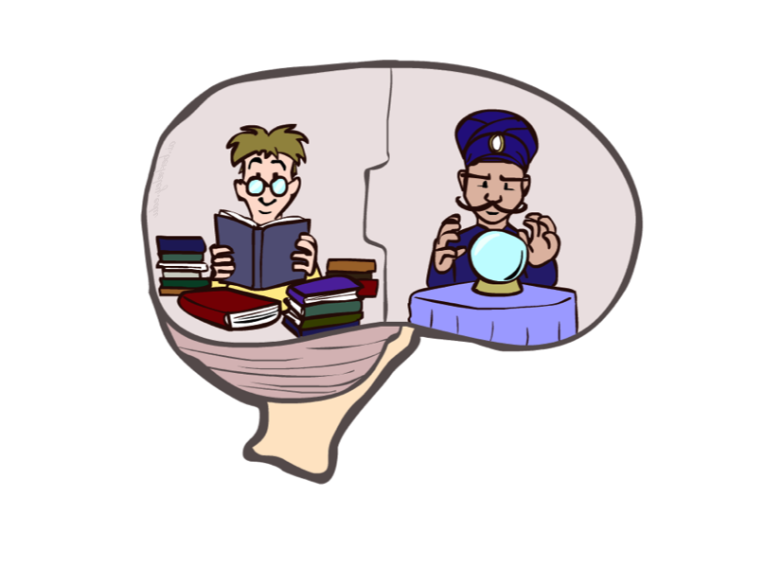
Course Topics
Part I: Solving Problems by Searching
  Fast search / planning
  Constraint satisfaction
  Heuristics
  Adversarial and uncertain search
Part II: Knowledge, reasoning, and Planning
  Reasoning agents
  Propositional logic
  Predicate logic
  Knowledge-based systems
Part III: Machine Learning
  Classification
  Clustering
  Neural Networks

Slide 8
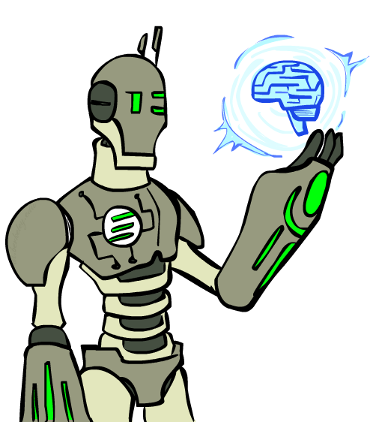
Overview
What is artificial intelligence?
What can AI do?
What is this course?

Slide 9
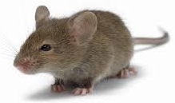
Question
  Is this mouse intelligent?
    It depends on context
    Route planning (Yes)
    Mathematical problem solving (No)
Is Google Intelligent?
  Can google drive a car?
  Task specific intelligence
Are humans intelligent?

Slide 10
WHY AI?
Why can't we simply program every possible situation?
Imagine making software for
  Self-driving cars
  You can write
    IF person crosses road
    THEN stop
  But what about
    fog
    rain
    child running
    broken traffic light
    cyclist
    ambulance
    dog
  Thousands of possibilities. Traditional programming starts failing.
AI helps machines
  learn
  reason
  decide

Slide 11
Why AI?
Two main goals of AI:
  To create useful “smart” programs able to do tasks that would normally require a human expert
  To understand human intelligence better as we test theories of human intelligence by writing programs which emulate them

Slide 12
What is Intelligence?
Ability of problem solving
  Example: Finding the shortest path to university.
Ability to think, plan and schedule
  Preparing timetable before exams.
Efficient memory and information manipulation
  Remembering previous mistakes.
Ability to tackle ambiguous and fuzzy problems
  A fuzzy problem does not have crisp, exact values — it deals with “how much” rather than “yes or no.”
Ability to understand and perceive

Slide 13
Artificial Intelligence
“Study of computations that make it possible to perceive, reason and act.”
Branch of Science which deals with helping machines to find solutions to complex problems in a more human-like fashion
In short, putting human intelligence into machines

Slide 14
Artificial Intelligence
What is Intelligence ??
Perceive
Understand
Remember
Think
Reason
Learn from Experience
Adapt to the new Situation
Problem Solving

Slide 15
Humans Vs Machines
Humans | Machines
Symbolic calculation Natural language understanding Not very precise Knowledge Generalize from examples Deal with noisy inputs | Numeric calculation Machine Language Precise Data Cannot generalize Cannot deal with noise

Slide 16
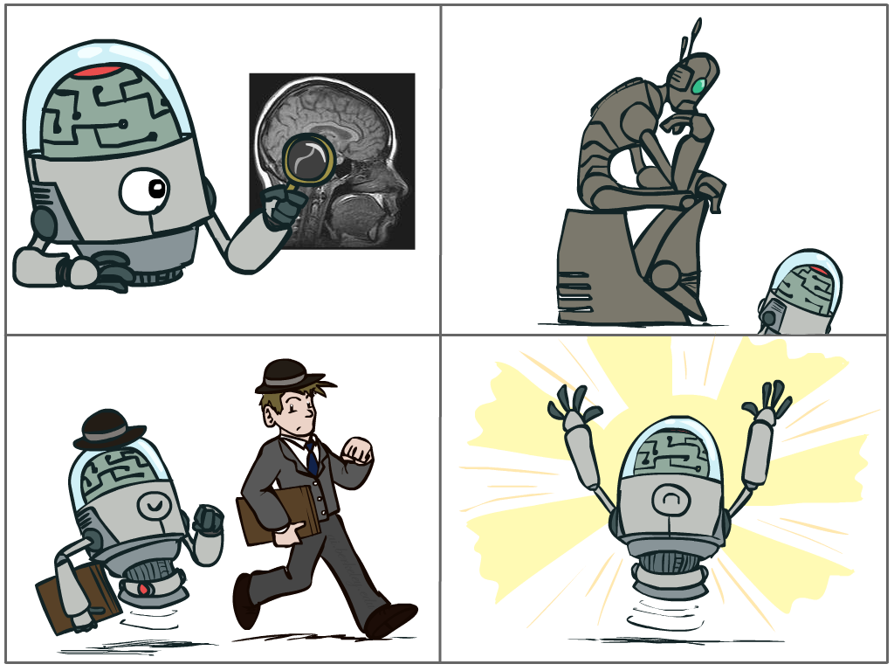
What is AI?
The science of making machines that:
Think like people
Think rationally
Cognitive modeling approach
Laws of thought approach
Act like people
Act rationally
Turing Test
approach
Rational agent approach
Notes:
Top left: Think like people --- cognitive science, neuroscience
Bottom left: act like people --- actually very early definition, dating back to Alan Turing --- Turing test; problem to do really well you start focusing on things like don’t answer too quickly what the square root of 1412 is, don’t spell too well, and make sure you have a favorite movie etc. So it wasn’t really leading us to build intelligence
Think rationally – long tradition dating back to Aristotle --- but not a winner, because difficult to encode how to think, and in the end it’s not about how you think, it’s about how you end up acting

Slide 17
What is AI?
Cognitive Modelling Approach:
  This approach tries to answer: “how do humans think?” and then replicate the thinking process. Based on Psychology, neuroscience, and cognitive science.
Law of thought Approach:
  Use mathematical logic to derive correct conclusions. (Propositional Logic, Predicate Logic, Theorem)
  Example:
    All humans are mortal
    Socrates is human
    → Socrates is mortal
Turing Test:
  If a machine behaves like a human, it is intelligent.
  Limitation:
  It measures imitation, not true intelligence.
  A system can trick humans without real understanding.
Rational Agent Approach:
  Acts to maximize expected performance given what it knows.
  Example:
    Self-driving car:
    Doesn’t need to drive like a human
    It just needs to drive safely and efficiently

Slide 18
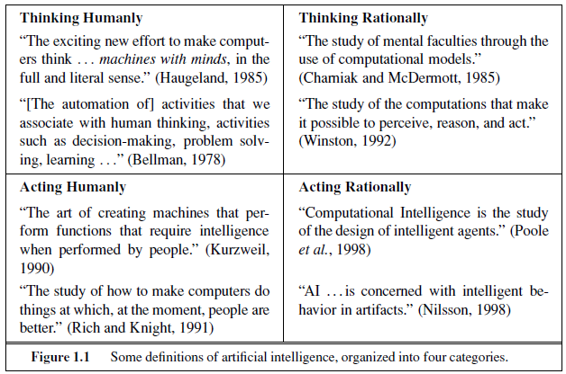
What is Artificial Intelligence

Slide 19
What is Artificial Intelligence?
Artificial intelligence (AI) refers to the development of computer systems that can perform tasks that typically require human intelligence. These tasks include understanding natural language, recognizing patterns, learning from experience, reasoning, and making decisions

Slide 20
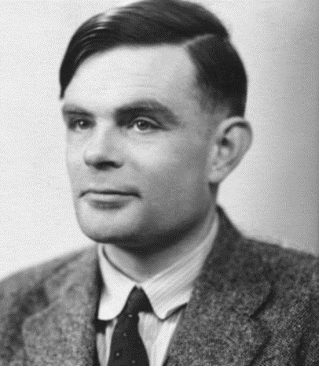
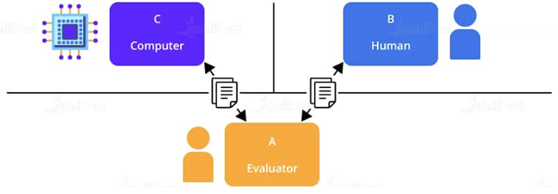
Acting Humanly:
Turing Test
Alan Turing (1950) “Computing machinery and intelligence”.
A computer passes the test if a human interrogator, after posing some written questions, cannot tell whether the written responses come from a person or from a computer.

Slide 21
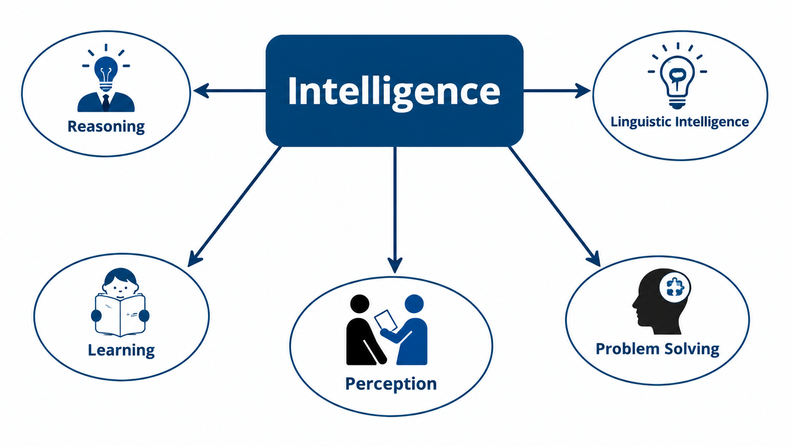
Turing Test Capabilities

Slide 22
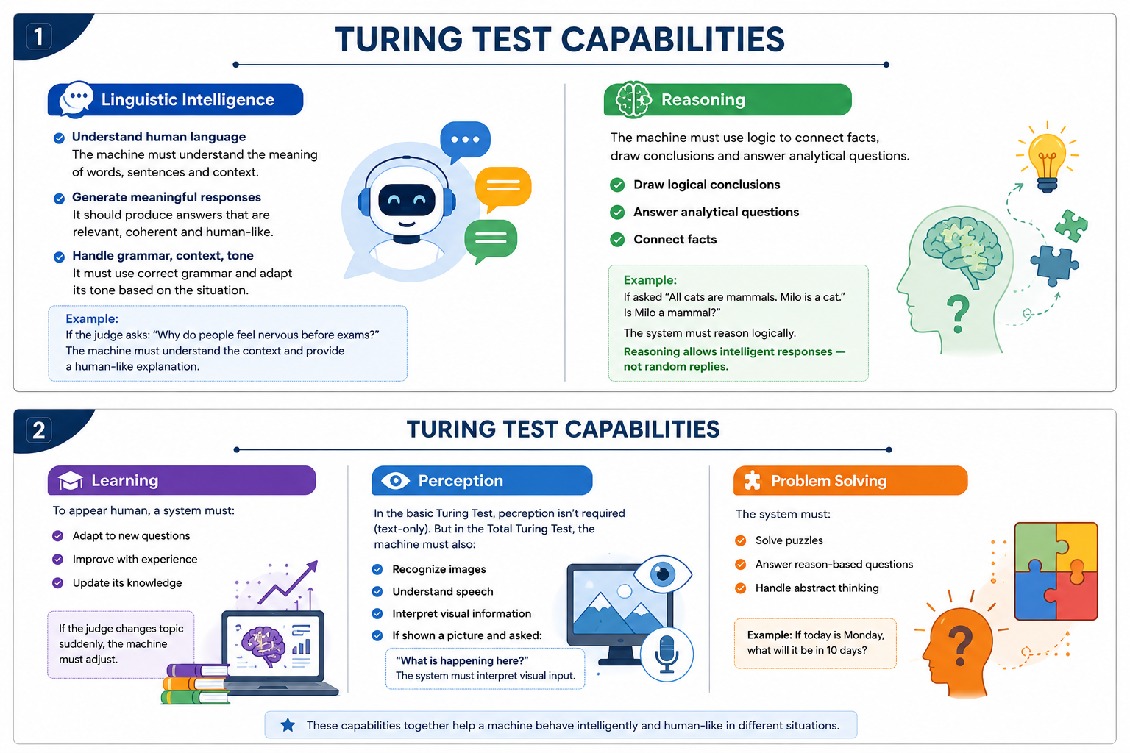

Slide 23
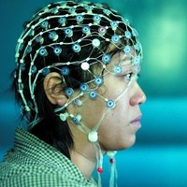
Thinking Humanly:
The cognitive modeling approach
Requires scientific theories of internal activities of the brain.
  Cognitive Science: Predicting and testing behavior of human subjects (Hypothesis based)
  Cognitive Neuroscience: Direct identification from neurological data (Data driven)
However:
  the available theories do not explain anything resembling human-level general intelligence – can not understand full human creativity, general intelligence, flexible reasoning
  It may be impossible to identify the detailed structure of human problem solving using only externally-available data. We can not fully know exact mental steps, all neural connections, complete internal representation because thoughts are not directly observable, brain is extremely complex.

Slide 24
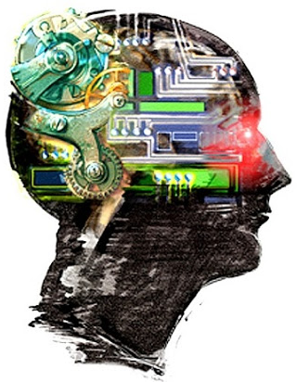
Thinking Humanly:
The cognitive modeling approach
For that we must determine how humans think.
Need to get inside the actual workings of human minds.
Three ways to do this:
Through introspection
  trying to catch our own thoughts as they go by
    When solving 27 × 14, what happened in your mind?
Through psychological experiments
  observing a person in action (color-word)
Through brain imaging
  observing the brain in action.

Slide 25
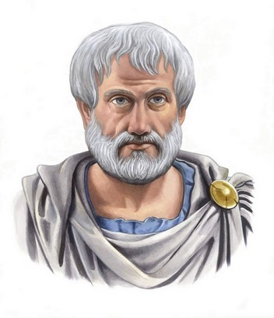
Thinking Rationally:
Laws of Thought
Aristotle: First to codify “right thinking”
  Right thinking: Thinking according to correct logical rules
Several Greek schools developed various forms of logic:
  Notation and rules of derivation for thoughts
  Propositional logic, Predicate logic, etc.
Always yield correct conclusions when given correct premises, logically wrong premises can lead to wrong results
  E.g. “Socrates is a man; all men are mortal; therefore, Socrates is mortal.”
These laws of thought were supposed to govern the operation of the mind; their study initiated the field called logic.

Slide 26
Thinking Rationally:
Laws of Thought
Problems:
Not easy to state informal knowledge in logical notation
  How do you translate "The soup is a bit too salty" or "She seems upset" into precise logical notation? How would you write these statements in mathematical logic?
  There is no clear answer because words like:
    Bit
    Seems
    Quite
    Almost
    Probably
  are subjective
Classical logic works with statements that are either:
True
False
Is 30°C hot?
  Depends on
    Weather
    Person
    Country
Humans understand this naturally.
Computers struggle.

Slide 27
Thinking Rationally:
Laws of Thought
Mostly work for toy examples
  A simplified, small, artificial problem created for teaching or testing ideas — not a real-world complex situation.
Big difference between solving a problem "in principle" and solving it “in practice”
  Problems with just a few hundred facts can exhaust the computational resources of any computer

Slide 28
Thinking Rationally:
Laws of Thought
How to measure if a program is thinking rationally
Can we see someone's thoughts?
  Student A solves a math problem using one method.
  Student B solves it using another method.
  Both get the correct answer.
  Can we say whose thinking was better?
  No. We judge them based on the result, not their internal thought process. The same applies to AI.
We evaluate:
Did the robot reach the destination?
Did the chess program win?
Did the medical AI diagnose correctly?
Conclusion:
  Right Thinking
  Must have rules and logic
  Complex and Hard

Slide 29
Acting rationally:
Rational agent
An agent is anything that perceives its environment through sensors and acts upon that environment through actuators.
  Actuators: The mechanism through which an agent acts upon its environment.
Sensors → Agent → Actuators
  Sensors = Perception (input)
  Actuators = Action (output)
Self-Driving Car
Sensors:
  Camera
  Radar
  Lidar
Actuators:
  Steering wheel control
  Brakes
  Accelerator
The car perceives the road using sensors
and acts by moving steering/brakes via actuators.
Notes:
launched on Mars in 2011; whether the planet could have ever supported microbial life.

Slide 30
Acting rationally: Rational agent
All computer programs do something, but computer agents are expected to do more:
  1. Operate autonomously (No constant human control)
    Example:
    A calculator waits for input. (Not an agent)
    A thermostat automatically adjusts temperature.
  2. Perceive their environment
  Example:
  A robot vacuum:
  Environment → Floor, walls, furniture
  Sensors → Infrared sensors, bump sensors
  Perception → Detects obstacle
  Action → Changes direction
  If it cannot sense obstacles, it cannot behave intelligently.
  3. Persist over a prolonged time period
    Program → Runs → Stops
    Agent → Continuous operation
    Example:
    A sorting program runs once and finishes. (Not an agent)
    A spam filter keeps running daily.
Notes:
launched on Mars in 2011; whether the planet could have ever supported microbial life.

Slide 31
Acting rationally: Rational agent
  4. Adapt to change, and create and pursue goals.
    Environment changes → Agent updates behavior
    Goal → Plan → Action → Evaluate → Adjust
    Example:
    If traffic increases, navigation app chooses new route.
    If opponent changes strategy, game AI adapts
    Example:
    Ordinary Program: Follow fixed instructions
    Agent: Choose actions to achieve a goal
  5. Make correct inferences
    Example:
    If road is wet → infer it might be slippery.
    If user searches “cold medicine” → infer user may be sick.

Slide 32
Acting rationally:
Rational agent
A rational agent is one that acts so as to achieve the best outcome or, when there is uncertainty, the best expected outcome.
Rational behavior: doing the right thing
The right thing: the optimal (best) thing that is expected to maximize the chances of achieving a set of goals, in a given situation
Making correct inferences is part of being a rational agent
There are also ways of acting rationally that cannot be said to involve inference -- Reflex actions.

Slide 33
Acting rationally:
Rational agent
If you wanted to build an AI doctor, should it think exactly like a human doctor, or should it simply make the best medical decision?
Advantages over other approaches
  More general than the "laws of thought" approach. Laws of thought approach assumes that every decision can be made using logical rules. Can a self driving car only work using logic?
  Google Maps uses traffic prediction, GPS, road conditions, and travel history. Is it only using logic?
  More obedient to scientific development than approaches based on human behavior or human thought
  Standard of rationality (Logic) is mathematically well defined and completely general
  Conclusion:
  Behave in right manner
  Give max. Performance
  Give Optimal Solution

Slide 34
Designing Rational Agents
Sensors
Agent
Percepts
Environment
?
Actuators
An agent is an entity that perceives and acts.
A rational agent selects actions that maximize its (expected) utility.
  Rational: Choosing the best possible action given available information.
  Utility: A numerical measure of how desirable an outcome is.
Characteristics of the percepts, environment, and action space dictate techniques for selecting rational actions
    Self-Driving Car
    Percept: Camera sees red light
    Agent: Decides to stop
    Actuator: Apply brakes
This course is about:
  General AI techniques for a variety of problem types
  Learning to recognize when and how a new problem can be solved with an existing technique
Actions

Slide 35
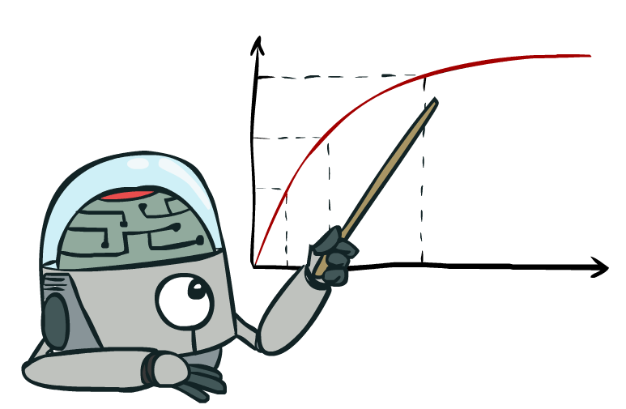
Rational Decisions
We’ll use the term rational in a very specific, technical way:
Rational: maximally achieving pre-defined goals
Rationality only concerns what decisions are made (not the thought process behind them)
Goals are expressed in terms of the utility of outcomes
Being rational means maximizing your expected utility
Notes:
Goals are expressed in terms of the utility of outcomes : mean to maximize overall utility in every aspect possible

Slide 36
Approaches to AI
Strong AI
  Strong AI aims to build machines that can truly reason and solve problems who is self aware and whose overall intellectual ability is indistinguishable from that of a human being.
    Human-Like
Weak AI
  Weak artificial intelligence (weak AI), also known as narrow AI, is artificial intelligence that is focused on one narrow task.
  Deals with the creation of some form of computer-based artificial intelligence that cannot truly reason and solve problems, but can act as if it were intelligent.
  Siri is a good example of narrow intelligence.

Slide 37
Weak and Strong AI
Weak AI is AI that can not 'think', i.e. a computer chess playing AI does not think about its next move, it is based on the programming it was given, and its moves depend on the moves of the human opponent.
Strong AI is the idea/concept that we will one day create AI that can 'think' i.e. be able to play a chess game that is not based on the moves of the human opponent or programming, but based on the AI's own 'thoughts' and feelings and such, which are all supposed to be exactly like a real humans thoughts and emotions and stuff.

Slide 38
Quick Quiz
To what extent are the following computer systems instances of artificial intelligence:
  Supermarket bar code scanners.
    Do they perceive the environment? (they “read” the barcode)
    Do they act autonomously? (only respond to human scanning)
    Do they adapt or learn? (do not change behavior or improve)
    Do they have goals? (no independent goal)
    Conclusion: Not an AI agent, just a program executing fixed algorithm.
  Web search engines.
  Voice-activated telephone menus.

Slide 39
Applications of AI
Game playing
Computer vision
Natural language processing
Diagnosis systems
Control
Optimisation
Robotics

Slide 40
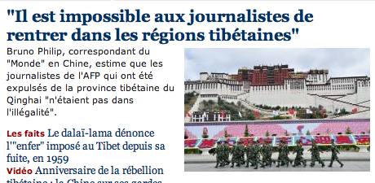

Natural Language
Speech technologies (e.g. Siri)
  Automatic speech recognition (ASR)
  Text-to-speech synthesis (TTS)
  Dialog systems
Language processing technologies
  Question answering
  Machine translation
  Web search
  Text classification, spam filtering, etc…

Slide 41


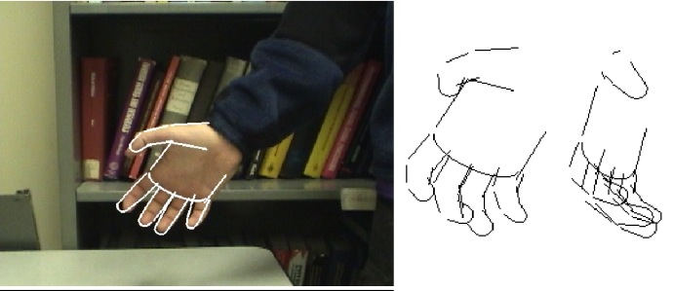

Vision (Perception)
Object and face recognition
Scene segmentation
Image classification (say hand pic as hand)

Slide 42
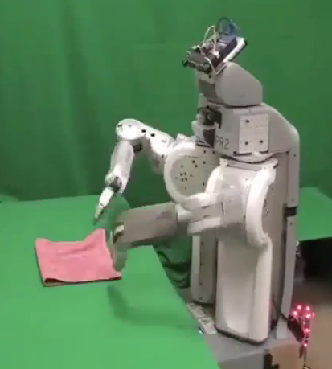
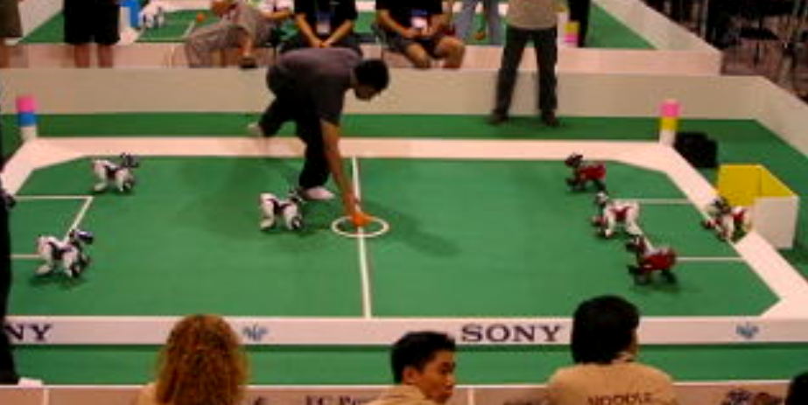
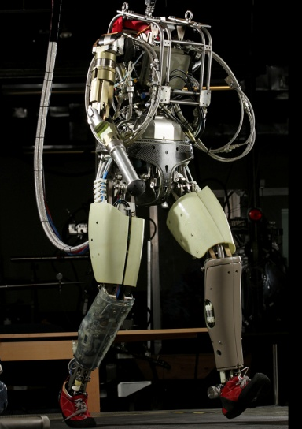
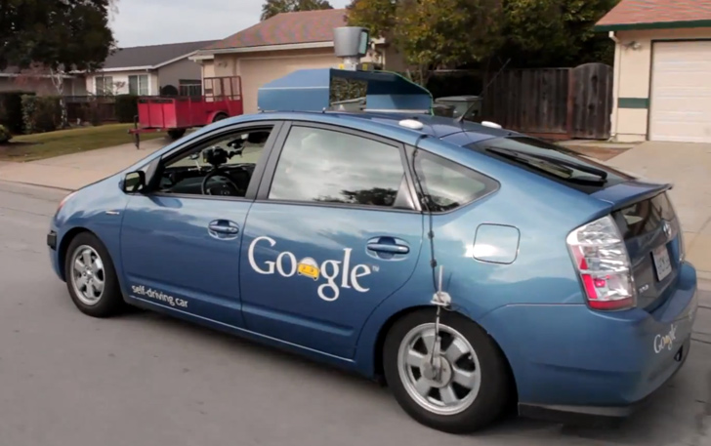
Robotics
Robotics
Technologies
  Vehicles
  Rescue
  Soccer!
  Lots of automation…

Slide 43

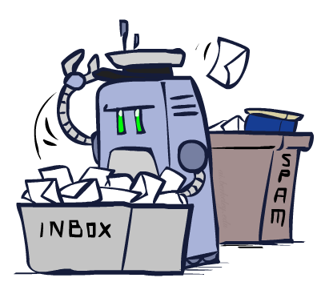
Decision Making
  Applied AI involves many kinds of automation
    Scheduling, e.g. airline routing, military
    Route planning, e.g. Google maps
    Medical diagnosis
    Web search engines
    Spam classifiers
    Automated help desks
    Fraud detection
    Product recommendations
    … Lots more!
Notes:
All applications can be thought of as decision making or useful sub-components of decision making

Slide 44
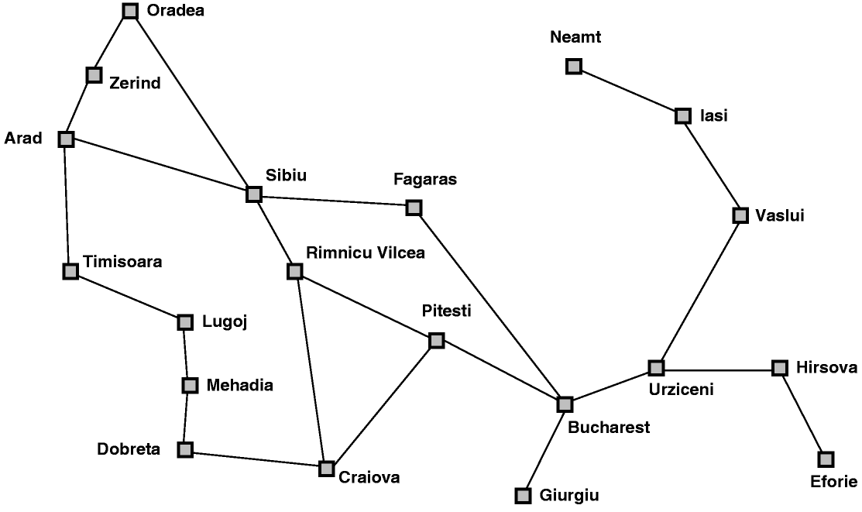
AI Topics: A Quick Introductory Overview
Classic AI search problems: Map searching (navigation)

Slide 45
AI Topics: A Quick Introductory Overview
Classic AI search problems
  3*3*3 Rubik’s Cube

Slide 46
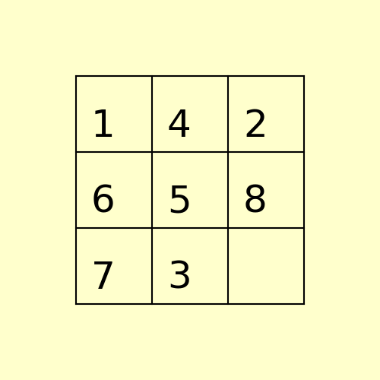
Classical AI Search Problems
8-Puzzle
1
4
2
1
2
3
6
5
8
4
5
6
7
3
7
8

Slide 47

Classical AI Search Problems

Slide 48
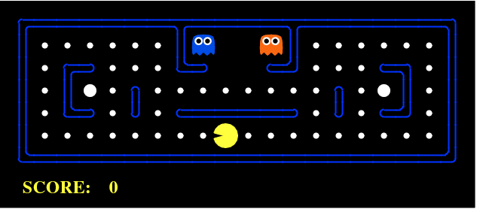
Classical AI Search Problem
Pac-Man

Slide 49
Important Features of Artificial Intelligence
The use of computers to do reasoning, pattern recognition, learning, or some other form of inference.
medical research papers to suggest cancer treatments based on symptoms and past cases.
A focus on problems that do not respond to algorithmic solutions. This underlies the reliance on heuristic search as an AI problem-solving technique.
Instead of checking every possible move (which is impossible in real time), AI uses heuristics to evaluate the best moves.
A concern with problem-solving using inexact, missing, or poorly defined information and the use of representational formalisms that enable the programmer to compensate for these problems.
Self-Driving Cars (Tesla, Waymo) – The AI must navigate in foggy conditions, recognize road signs even if they are partially hidden, and make real-time driving decisions with incomplete data.
Reasoning about the significant qualitative features of a situation.
Medical Diagnosis AI – AI doesn't just check symptoms but also considers the patient's history, lifestyle, and genetic factors to recommend treatment.
An attempt to deal with issues of semantic meaning as well as syntactic form.
Google Search – AI understands the intent behind a user’s search query, not just the keywords. For example, searching "Apple" could mean the fruit or the company, and AI uses context to decide.
Notes:
Inference is the process of drawing conclusions or making decisions based on known information, facts, or reasoning.

Slide 50
Important Features of Artificial Intelligence
Answers that are neither exact nor optimal, but are in some sense “sufficient”. This is a result of the essential reliance on heuristic problem-solving methods in situations where optimal or exact results are either too expensive or not possible.
Spam Filters – AI doesn’t perfectly classify every email, but it filters enough spam to make email useful without blocking real messages.
The use of large amounts of domain-specific knowledge in solving problems. This is the basis of expert systems.
AI was used in the 1970s to diagnose blood infections based on an extensive database of medical knowledge.
The use of meta-level knowledge to effect more sophisticated control of problem-solving strategies. Although this is a very difficult problem, addressed in relatively few current systems, it is emerging as an essential area of research.
AlphaZero (Game AI by DeepMind) – It learns to play Chess by adjusting its own strategies dynamically, improving over time without human intervention.
Self learning through trial and error, use reinforcement learning.

